Slide 1
ICT710 – Interaction Design and Usability
Assignment 3
PART B
Presented By:
Preethi Edukulla (66993)
Saikiran Bitla (66158)
Varshini Koyyalamudi (65079)
Rasagna Karingula (65411)
Ravichandra Atthuluri (64812)

Slide 2
Introduction
The online mobile trading application is developed for improve the stock and cryptocurrency trading activities.
The additional requirement of this application including searching, purchasing, selling, fund transfers and chatbot support.
The application aims to enhance the efficiency, security and quality of trading experience.
The usability testing and user analysis report is considered before the development of online mobile trading application.
Notes:
The development of this online trading application is based on designing a mobile application for trading stocks and cryptocurrencies. The application has a variety of important functions, including asset purchasing and selling, bank transfers, auto trading and chatbot support. The design was created based on users' needs and usability testing. The primary objective is to provide a user-friendly, secure and simple trading experience.

Slide 3
Design Process
The process of application design started after user feedback analysis and usability findings.
Wireframes are created with clear structure dashboard layout, navigation and feature accessibility[1].
Trading functions are strategically located to minimize confusion and enhance user task efficiency.
The user interface was designed with simplicity, readability, accessibility and smooth user interaction experience.
Notes:
The above slide discuss about the design process and it started by analyzing user feedback collected from surveys and usability testing. The team also mapped common usability issues and users' expectations before designing the interface. Wireframes were then created to structure the application and the flow of screens. Navigation, accessibility and visibility of key functions was a special consideration, enhancing overall user experience.

Slide 4
Design Process (Cont.)
The mobile app prototype has been designed and developed using Figma tools.
The application interface design using modern colors, simple and clear fonts, and simple icons[2].
Poor navigation, visibility and feature accessibility issues are some issues identified during user feedback sessions.
Some improvements are made in the interfaces to increase usability, user confidence and overall interaction quality[3].
Notes:
The final prototype was designed using Figma to design realistic mobile screens of the application. The interface was designed to be easy to understand with a clean layout, readable text and clear icons. Test users and group members offered suggestions for improvements based on their feedback. Various improvements have been made such as improved navigation visibility and improved feature organisation across screens.

Slide 5
Design rationale
The trading app was created with simple, consistent, and user-centered design principles to enhance the trading experience for every user.
The interface have clear structure, navigation options, and clean layouts.
A bottom navigation bar was added for the user to access the key features that including dashboard, markets, portfolio and trade[4].
The users can quickly recognize financial information with using visual strategies such as color contrast, larger typefaces, and structure information cards.
These enhancements increase the application of overall task completion efficiency, decrease user confusion, and improve usability.
Notes:
Its project covers that the smart trading app with simple, navigate, structure, and visual were employ to enhance the usability, decrease confusion, and assist users in completing trade task quick and effective.

Slide 6
Design Rationale (Cont.)
The trading app design has incorporated with security and trust into account because users conduct critical financial operations.
The features like login, two-factor authentication, secure bank transfer confirmation, and notification alters were included to increase account security and user confidence.
The software also incorporates auto trading and chatbot support to increase efficiency and accessibility[5].
The chatbot provide trading advice and immediate assistance because the auto trading tool enables users to automate trading techniques.
So, these features will support for both novice and expert traders that will increase user engagement and decision-making.
Notes:
It demonstrates that security, chatbot help, and auto trading capabilities enable both novice and expert users to make financial decisions easier to enhancing the user trust, accessibility, and trading efficiency.

Slide 7
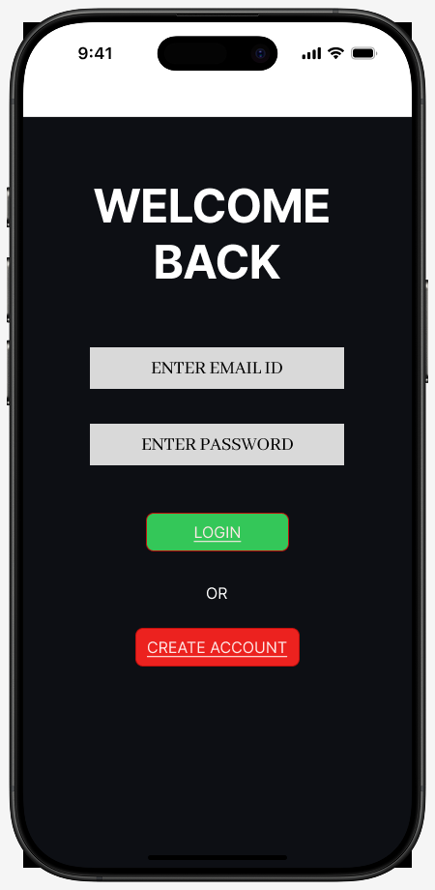
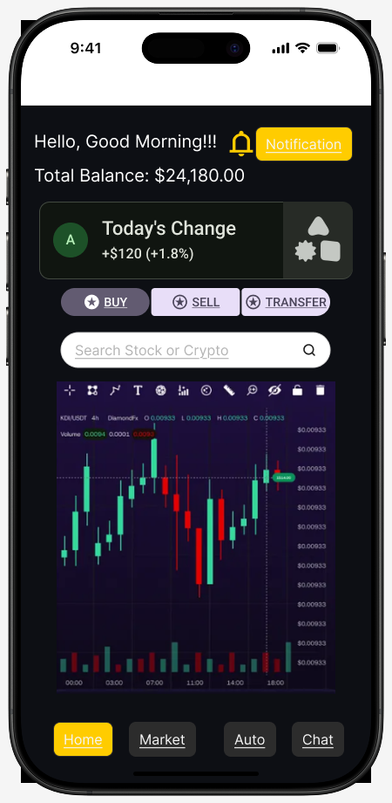
User Interface Design
Trading App branding is introduced through a modern minimalist trading aesthetics.
A secure authentication is given with login interface for simple accessibility and navigation.
The dashboard screen displays actions, balances, market trends and quick navigation.
The search function helps to locate stocks and cryptocurrency very quickly.
The bottom navigation is improved with accessibility among chatbot, trading, and transfer features[6].
Notes:
The slide used to give the information regarding the user interface design. Trading mobile app user design interface is designed with a user-friendly and modern layout which used to support a smooth navigation, accessibility and visual clarity. Welcome screen introduces TradeCore application with a modern interface and it directs users towards accessing the application using the registration.

Slide 8
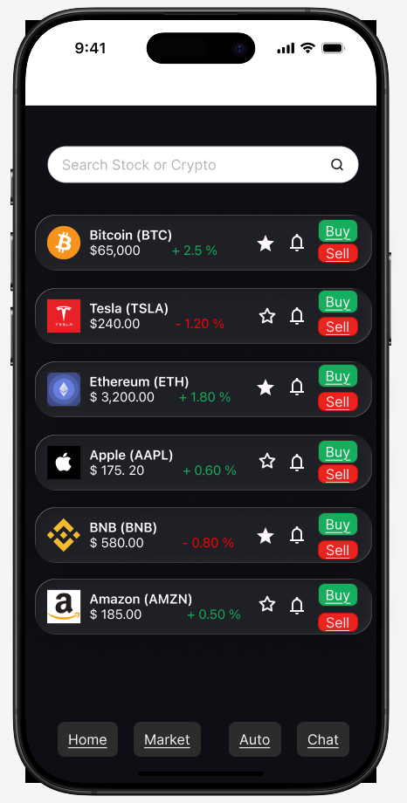
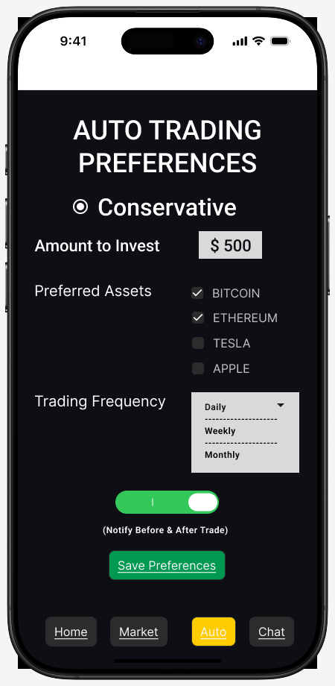
User Interface Design (Cont.)
The price alert screen notify users based on the important changes in cryptocurrency values.
Faster monitoring will be happened in watchlist features for the favorite assets without a search.
The investment strategies and notification management options is given in auto trading preferences.
Beginner users can get their support from chatbot assistance with interaction and guidance features[6].
Notes:
The slide used to give the information regarding the user interface design. An organized sections, consistent colors, interactive components and intuitive buttons were implemented to improve usability, enhance experiences of the users and simplify trading operations. The users are enabled in the preferences screen to customize investment amounts, trading frequency, preferred assets and notification settings for the automated features.

Slide 9
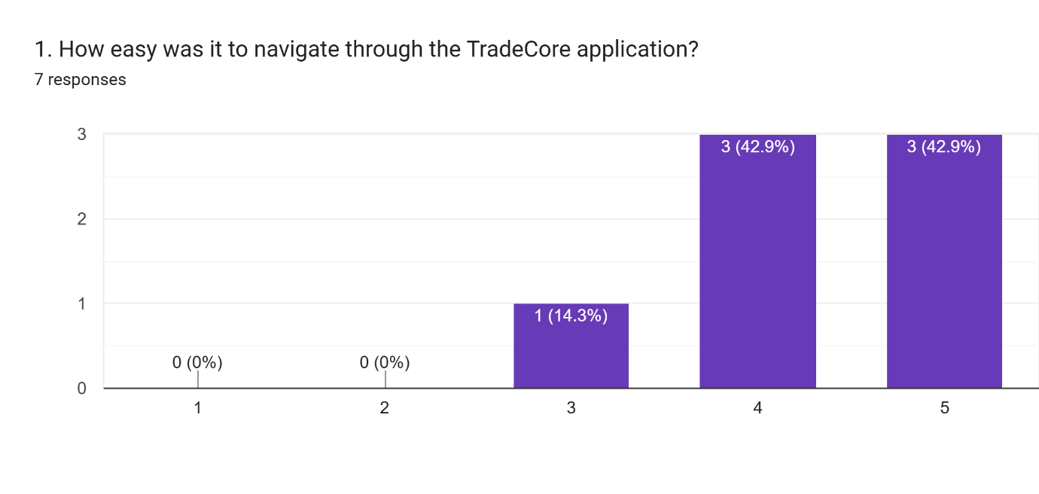
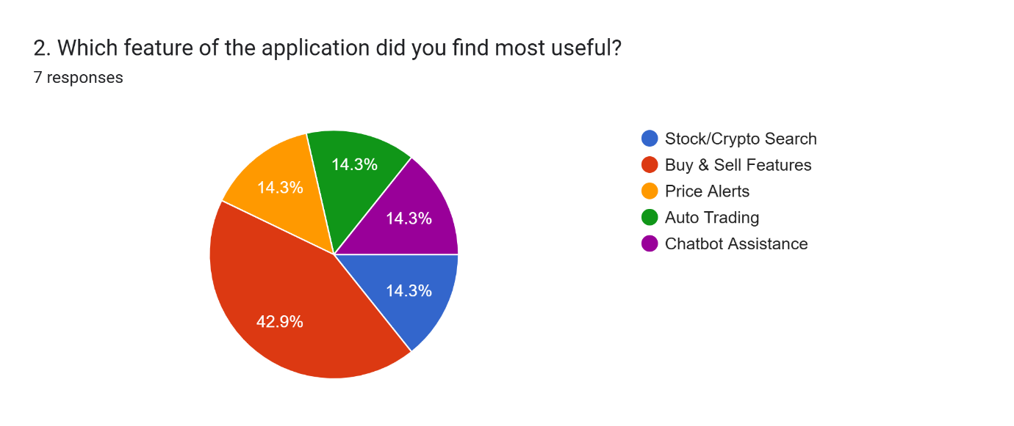
Usability Evaluation
The application navigation efficiency is evaluated for survey-participants through five-point rating scales.
Many users completes successfully with assigned trading tasks without any operational confusion.
Simplified interfaces are preferred by the participants to support navigation complexity and quick transactions.
Integrated watchlist features are appreciated by users for monitoring traded assets in frequent way[7].
A positive satisfaction level is indicated as survey responses based on application visual consistency.
Notes:
Usability evaluation for the Trading mobile Application is conducted using rigorous usability testing which is involved with many user tasks and survey-based feedback collection. Evaluation of participants are in navigation, responsiveness, interface clarity, and feature accessibility.

Slide 10
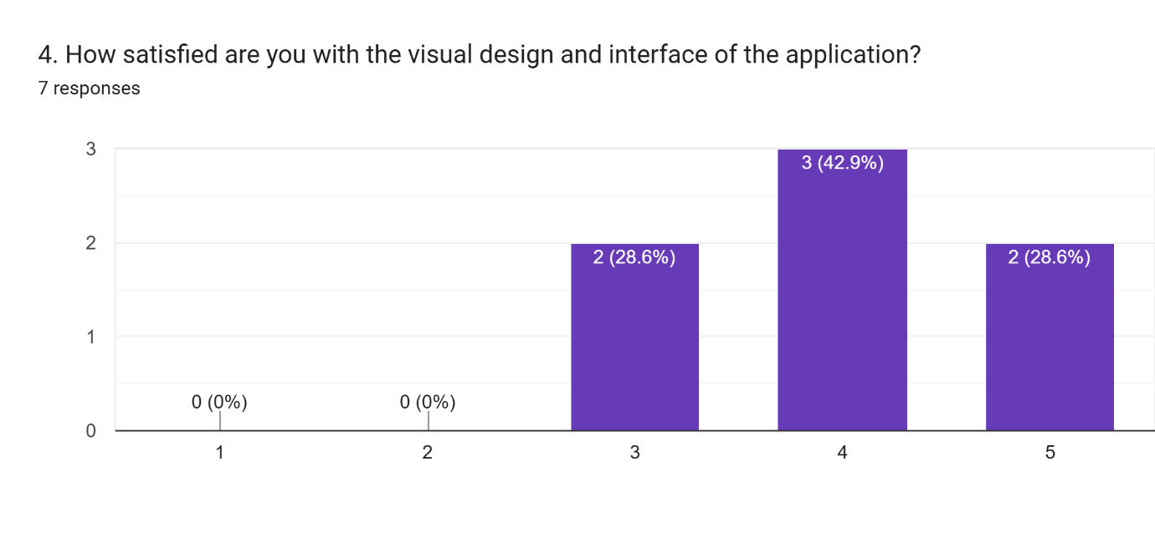
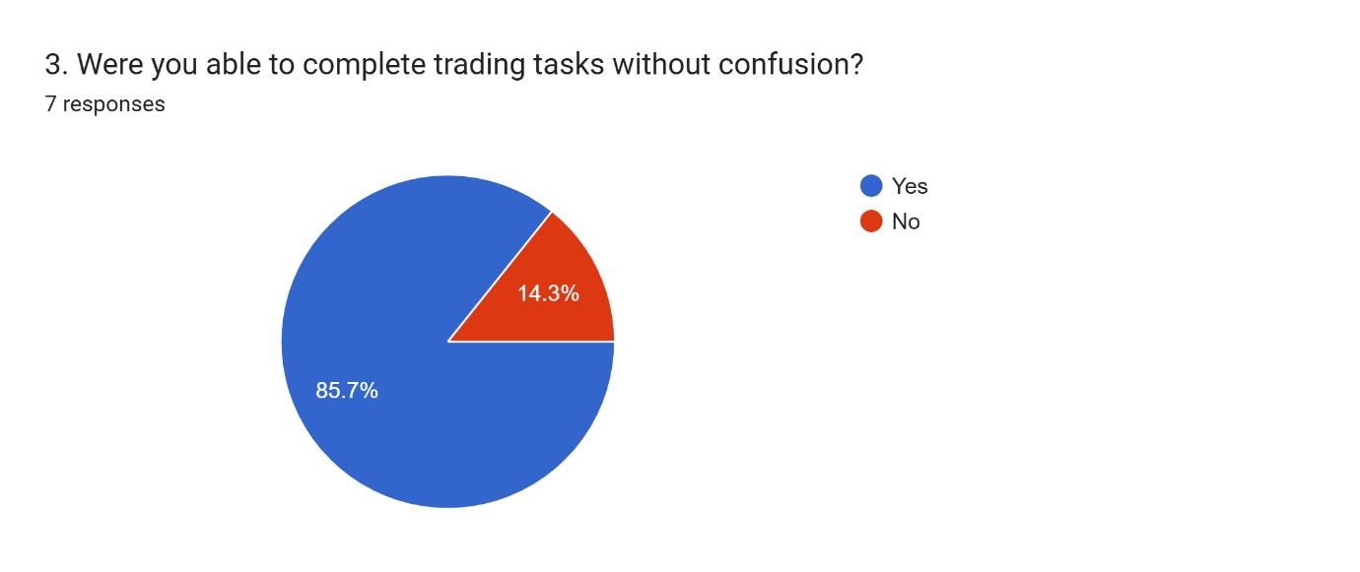
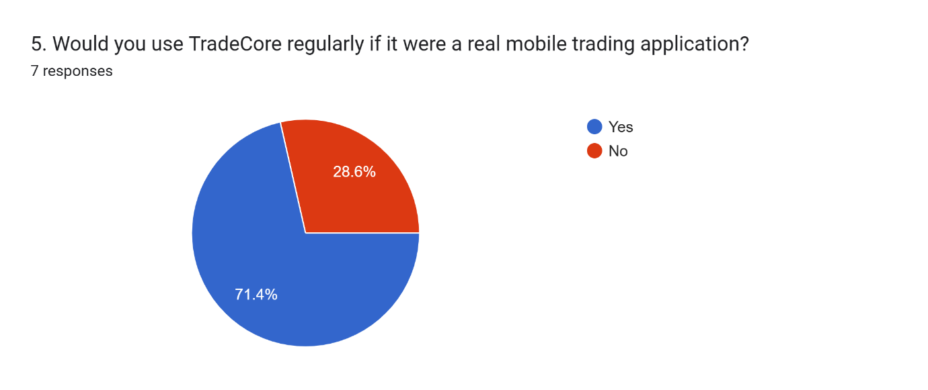
Usability Evaluation (Cont.)
User awareness is improved in price alert functionality based on cryptocurrency in market fluctuations.
User confidence is increased with auto trading customization using investment preference management.
Beginner difficulties are reduced with chatbot assistance by giving them a support at navigation.
It recommends chatbot intelligence, improve transaction feedback, and clarity systems[8].
Usability evaluation confirms TradeCore delivers a user-friendly and efficient trading experiences.
Notes:
This analysis helps in identifying strength like organized layouts, simple navigation and efficient task completion. The minor usability concerns are included with an improved transaction feedback and enhancement of chatbot responses.

Slide 11
Conclusion
The smart trading app redesign was created that enhanced the security, accessibility, usability, and navigation.
The whole user experience was improved with features that including chatbot support, auto trading, secure login, and simple trading processes.
The experiment illustrated the effective interaction design can enhance user satisfaction, reduce errors, and facilitate effective financial transactions for both novice and expert traders.
Notes:
The project enhanced navigation, security, and usability of the smart trading app. All users have effective, safe, and user-friendly trading experience depends on user-centred design and usability testing.

Slide 12
References
[1] | Z. Huang and M. Benyoucef, “An Empirical Study of Mobile Application Usability: A Unified Hierarchical Approach,” International Journal of Human–Computer Interaction, vol. 39, no. 13, pp. 2624-2643, 2021.
[2] | P. Weichbroth, “Usability of Mobile Applications: A Consolidated Model,” IEEE Access , vol. 12, pp. 62378 - 62391, 2024.
[3] | A. K. Srivastava, “Design a Real-Time Stock Trading Platform,” Medium, 14 June 2025. [Online]. Available: https://medium.com/@ankitviddya/design-a-real-time-stock-trading-platform-d4537cf5d0c7.
[4] | E. N., “Design quality of Mobile trading system application software for Smartphones,” Asian Journal of Management, vol. 7, no. 3, pp. 207-212, 201.
[5] | K. Rafalski, “Financial App Design: UX Strategies for High-Performance Mobile Trading,” netguru, 22 January 2026. [Online]. Available: https://www.netguru.com/blog/financial-app-design.
[6] | M. A. Faudzi, Z. C. Cob, M. Ghazali, R. Omar and S. A. Sharudin, “User interface design in mobile learning applications: Developing and evaluating a questionnaire for measuring learners' extraneous cognitive load,” Heliyon, vol. 10, no. 18, pp. 1-20, 2024.
[7] | M. Sandesara, M. D. Alshehri and M. S. Raboaca, “Design and Experience of Mobile Applications: A Pilot Survey,” Mathematics, vol. 10, no. 14, pp. 1-21, 2022.
[8] | A. Alzahrani, R. Alturki and V. Gay, “The Evaluation of the Usability in Mobile Applications,” Proceedings of the 40th International Business Information Management Association (IBIMA), pp. 56-69, 2022.

